Slide 1
Virtual Reality
Brianna Muleski
UW-Platteville, Computer Science

Slide 2
History
First appearance: 1960’s
Ivan Edward Sutherland
1968 paper: “A Head-Mounted Three Dimensional Display”
Incorporated 3D technology with computer graphics
Difference from 3D:
Perspective of viewer
Used computer to create graphics
Notes:
Known as the “father of virtual reality and computer graphics”
the term “virtual reality” was not used until the 1990s
Santa Barbara conference
group of researchers and professionals
devised “virtual reality” to describe the new discipline

Slide 3
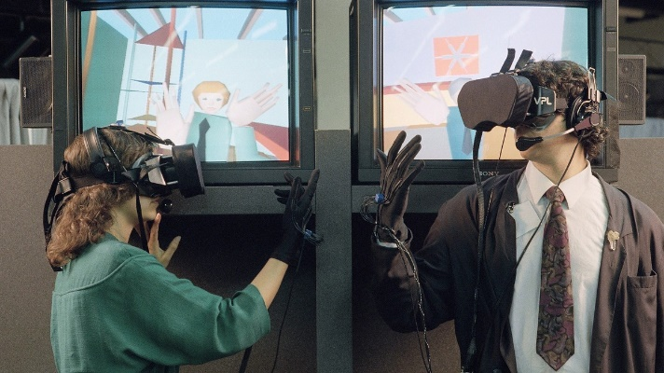
History
EyePhone
1989
Developed by VPL Research and NASA
Head-Mounted Display and data glove
First to use main aspects of today’s technology:
Immersive 3D space
Real-time interaction
Self-projection
Notes:
data glove used to interact with the virtual environment

Slide 4
Scene Graph
Abstract, logical access structure
Represents the environment structure and its relationships
Nodes:
Grouping
Children
Attribute
Notes:
Example:
root node (group)
3 nodes from it: 2 group nodes, 1 node
2 attribute node from 1 group node, 1 from another

Slide 5
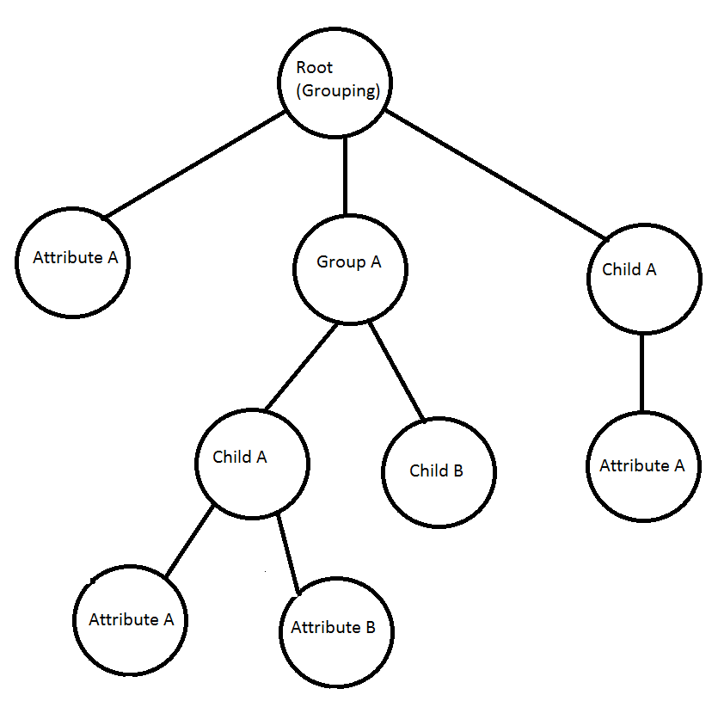
Scene Graph Example

Slide 6
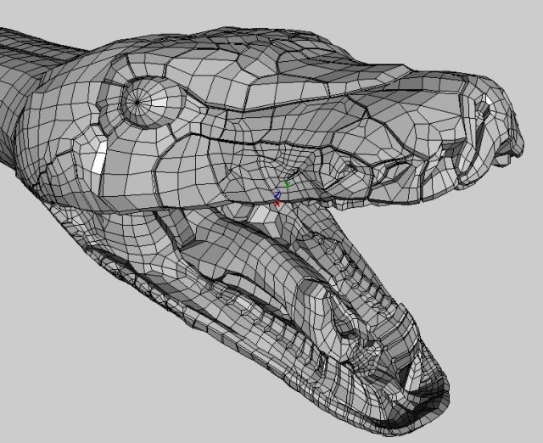
Virtual Reality Modeling Language
VRML:
Uses Scene Graph structure
Nodes:
Geometry nodes
Inline nodes
Anchor nodes
AudioClip nodes
MovieTexture nodes
VideoTexture nodes
“worlds” (*.wrl)
[4]
Notes:
Most of these nodes are treated as children nodes for a group node
Each node has its own attribute nodes
the dragon was made with wings3D, then exported to VRML
this presentation uses VRML 2.0

Slide 7
Geometry Nodes
Primitive Shapes
Boxes
Spheres
Cones
Cylinders
Use transformations to create objects from the basic shapes:
Rotations
Translations
Scalings
Notes:
Several types of geometry nodes:
Basic shapes:
boxes (cubes)
spheres
cones
cylinders
all are in 3D space
Transformations used to create different objects from the basic shapes
rotations – rotate about center of object
translations – move to another position on axes
scalings – make smaller/bigger

Slide 8
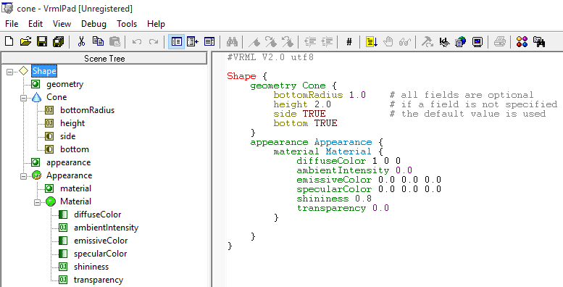
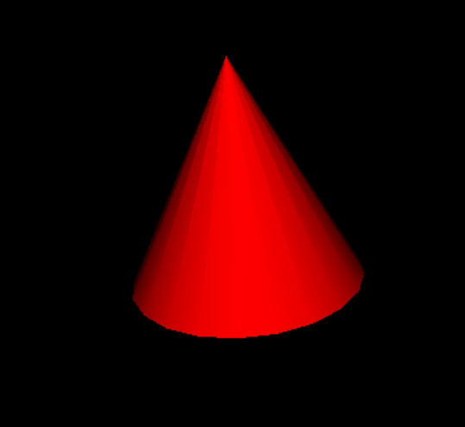
Geometry Nodes: Examples
Notes:
defaults:
radius: 1.0
height: 1.0
side: TRUE – boolean, specifies if the sides will be drawn
bottom: TRUE – boolean, specifies if the bottom will be drawn
center of the cone is at origin
Appearance node:
must be defined inside a shape node
all fields are optional:
material
texture
textureTransform
at least one field should be specified
Material node:
must be defined inside an appearance node
specifies:
color (all RGB)
light reflection
transparency
fields:
diffuseColor – color of object (in this case, red)
emissiveColor – used to define the glow of the object
specularcolor – used to define the color of shiny spots
shininess – intensity of shiny spots
transparency
0.0 = completely opaque
1.0 – completely transparent
all floating point values between 0.0 and 1.0

Slide 9
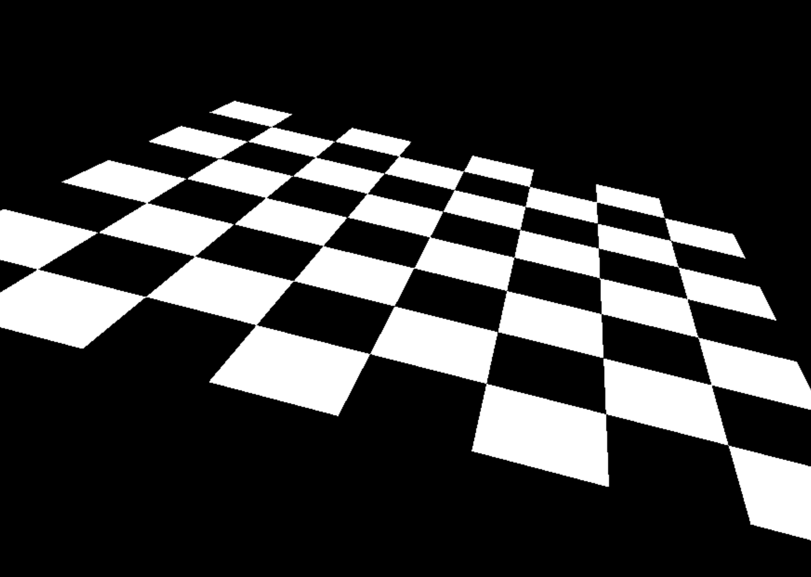
Geometry Nodes: Examples
Geometry Nodes are more than just shapes:
Chessboard:
Uses ElevationGrid
Others:
IndexedLineSet
polyines
IndexedFaceSet
planar faces
ElevationGrid:
XYZ dimensions
X: number of points along x-axis
Z: number of points along z-axis
Y: height of each face
Notes:
Geometry nodes include other types (advanced shapes):
IndexedLineSet
connection of polylines
IndexedFaceSet
connection of planar faces

Slide 10
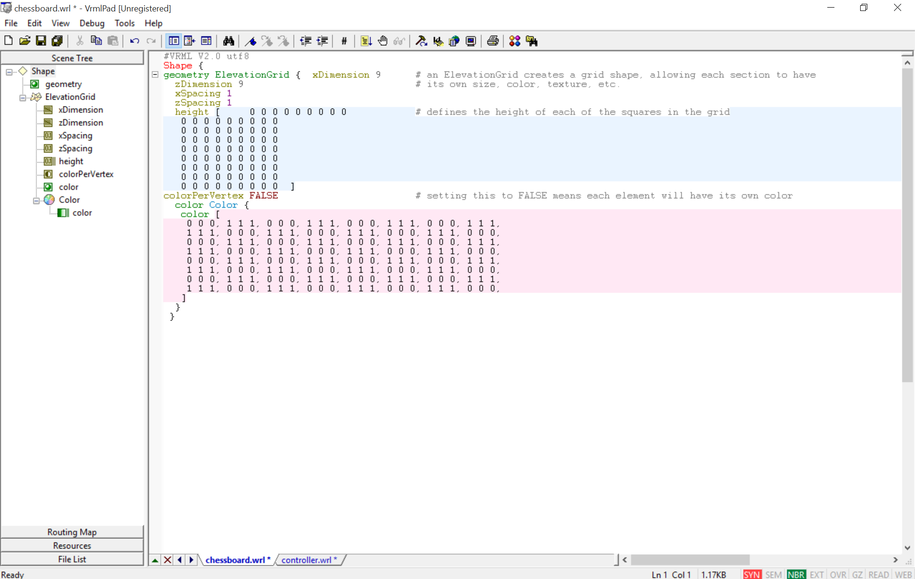

Slide 11
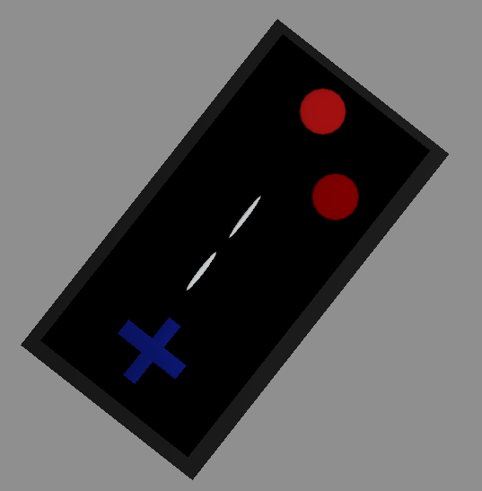
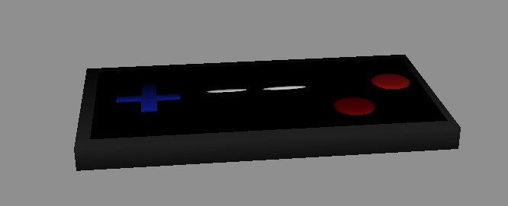
Geometry Nodes: Examples
Geometry nodes can be combined
Controller:
8 IndexedFaceSet nodes
Uses transformations
Notes:
Controller made using wings3D
uses transformations on 8 different IndexedFaceSet nodes
could have also used sphere and box nodes

Slide 12
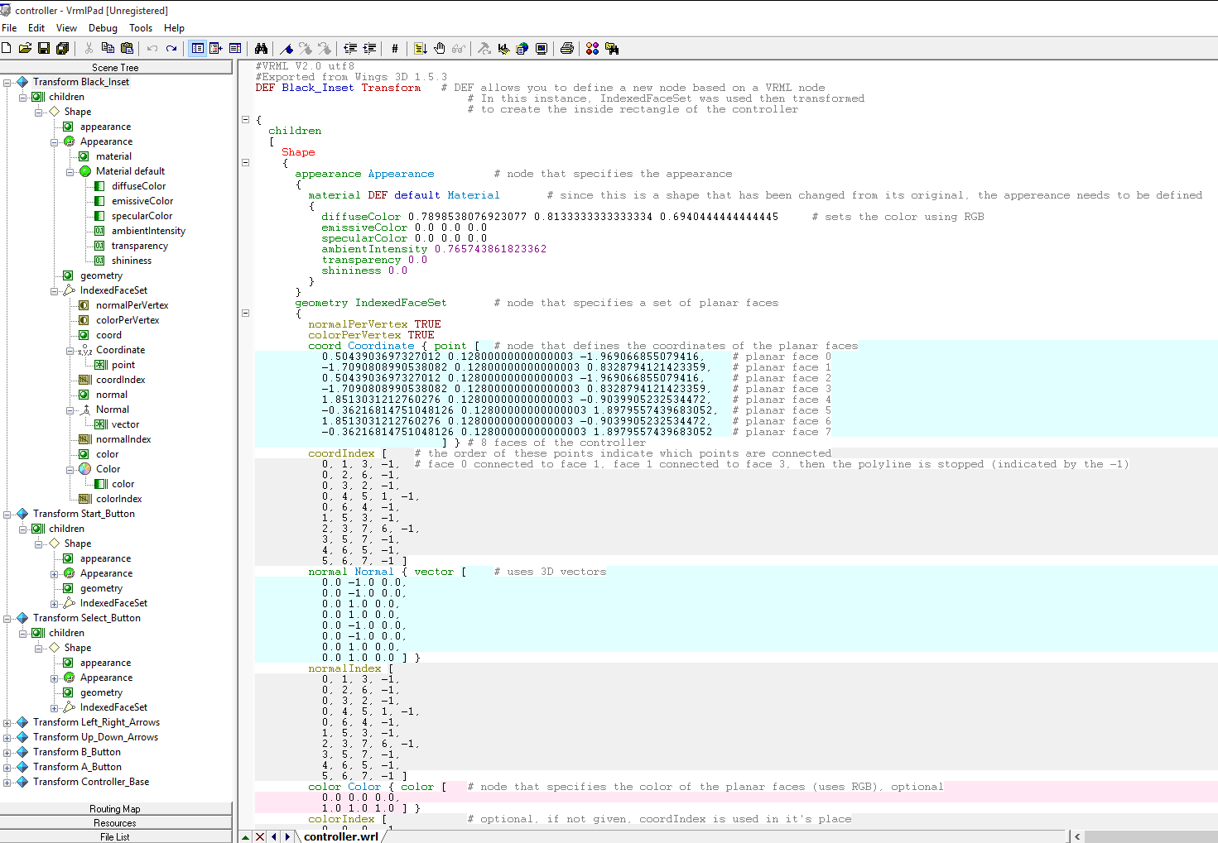

Slide 13
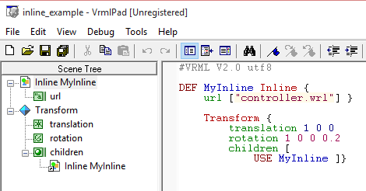
Inline Nodes
Allow reuse of files
Specifies a url for the data
Must be valid and complete VRML file
3 fields:
url – required; location of file
bboxCenter – optional; center of box that encloses the inlined file
bboxSize – optional; size of box that encloses the inlined file
Notes:
Used to reuse VRML files already made
optional fields will restrict figure to a specific area
used mainly for browser optimization
defaults are used if not specified
bboxCenter: 0 0 0
bboxSize: -1 -1 -1
implies no box is defined
Example shown:
reuses the controller and transforms it

Slide 14
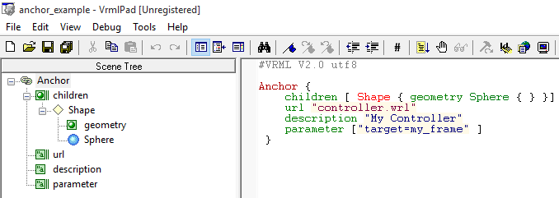
Anchor Nodes
Allow linking objects to a url
6 fields:
children – required; all linked objects
url – required; the linked url
parameter – required; additional information for the browser
description – required; string, information for user
bboxCenter – optional; center of box that encloses the children
3D point
bboxSize – optional; size of box that encloses the children
Notes:
Example:
clicking on the sphere will bring up the world specified in the url
description will show if the user hovers the mouse over the object(s) defined in children

Slide 15
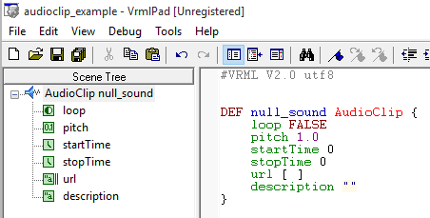
AudioClip Nodes
Allow audio playback
Must be MIDI or WAVE
6 fields:
loop – optional; boolean, specifies if the sound will loop
pitch – optional; specifies speed
startTime – optional; specifies start time in seconds
stopTime – optional; specifies stop time in seconds
url – optional; specifies location of sound clip
description – optional; string, describes the sound
Note: time is seconds since midnight of 01/01/1970
Notes:
January 1, 1970 is speculated to be used because of the birth of the Unix system
world gets “created” at this time, so time is from time the world is created
all the values given are the defaults
because no url is provided, no sound will be played
has 2 events:
isActive – true when playing
duration_changed – generated when url is changed. value is time in seconds of the sound

Slide 16
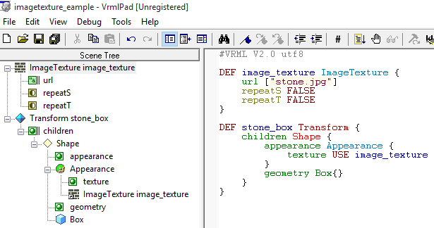
ImageTexture Nodes
Allow image use for texture
Must be JPEG, JPG, GIF, or PNG
3 fields:
url – optional; specifies the location of the image
repeatS – optional; boolean, specifies if the image is repeated vertically
repeatT – optional; boolean, specifies if the image is repeated horizontally
Notes:
if repeatS and repeatT are true, only repeated twice
textureTransform is needed to repeat more than twice
Example:
creates a box with the texture defined

Slide 17
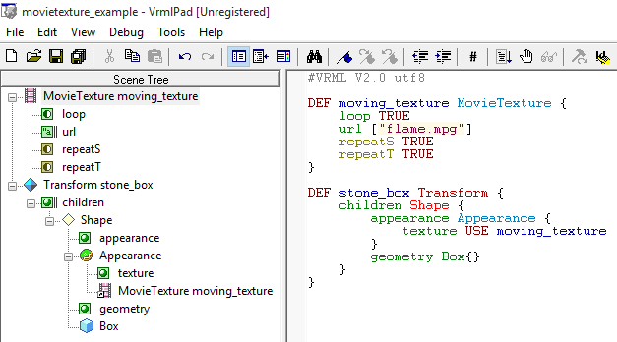
MovieTexture Nodes
Allow video use for texture
Must be MPEG
7 fields:
loop – optional; boolean, specifies if the video will loop
speed – optional; specifies speed
startTime – optional; specifies start time in seconds
stopTime – optional; specifies stop time in seconds
url – optional; specifies location of video clip
repeatS – optional; boolean, specifies if the image is repeated vertically
repeatT – optional; boolean, specifies if the image is repeated horizontally
Notes:
Example:
creates box with moving “flames” are texture

Slide 18
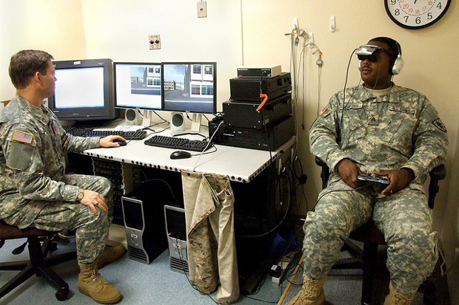
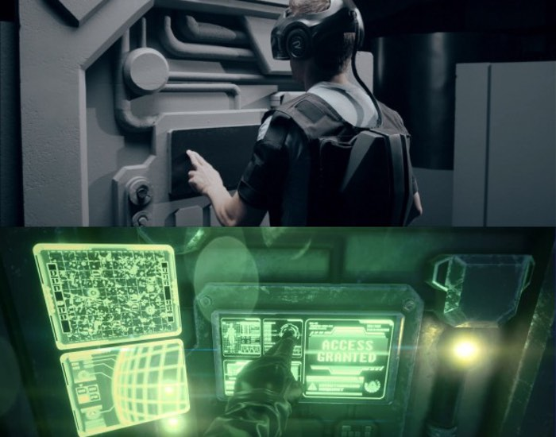
Applications
[5]
Entertainment
Gaming
PlayStation
Oculus
Microsoft
“The Void”
Medical
PTSD Therapy
OCD Therapy
[4]
Notes:
There are several different applications for virtual reality
most common and well-known:
gaming
PlayStation’s VR
Oculus Rift
Microsoft’s HoloLens
not as well-known:
“The Void” virtual reality theme park
medical applications:
PTSD and OCD therapy
use emmersive exposure therapy to overcome disorders
several studies show improvements when using this technique

Slide 19
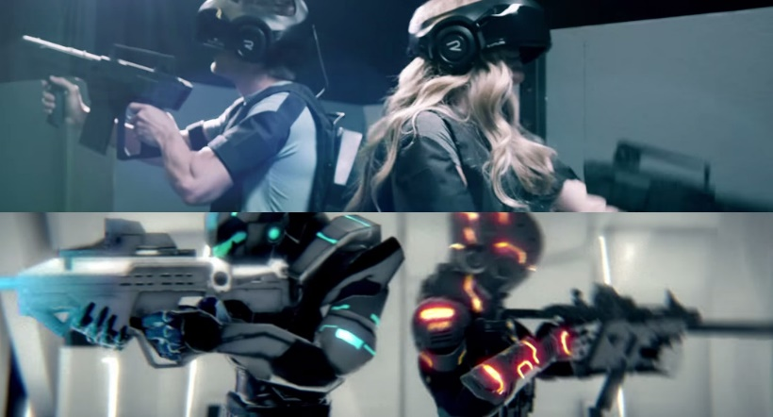
The Void
“The Vision of Infinite Dimensions”
The Void, LLC
Virtual Entertainment Centers (VECs)
Gaming Pods
Motion Simulators
4D elements
Notes:
The Void, LLC
based in Utah
Currently doing beta testing
Set to roll out first VEC in Summer of 2016
Uses 4D elements to immerse the user in the virtual environment
build virual worlds on top of physical environment
use mists, bursts of air, heaters to simulate environment features
VECS:
gaming pods:
walk through virtual world
current attractions:
Research facility
Dimension One
coming soon:
Poly Defense
Unreal Tournament Void
Motion simulators:
flight simulation

Slide 20
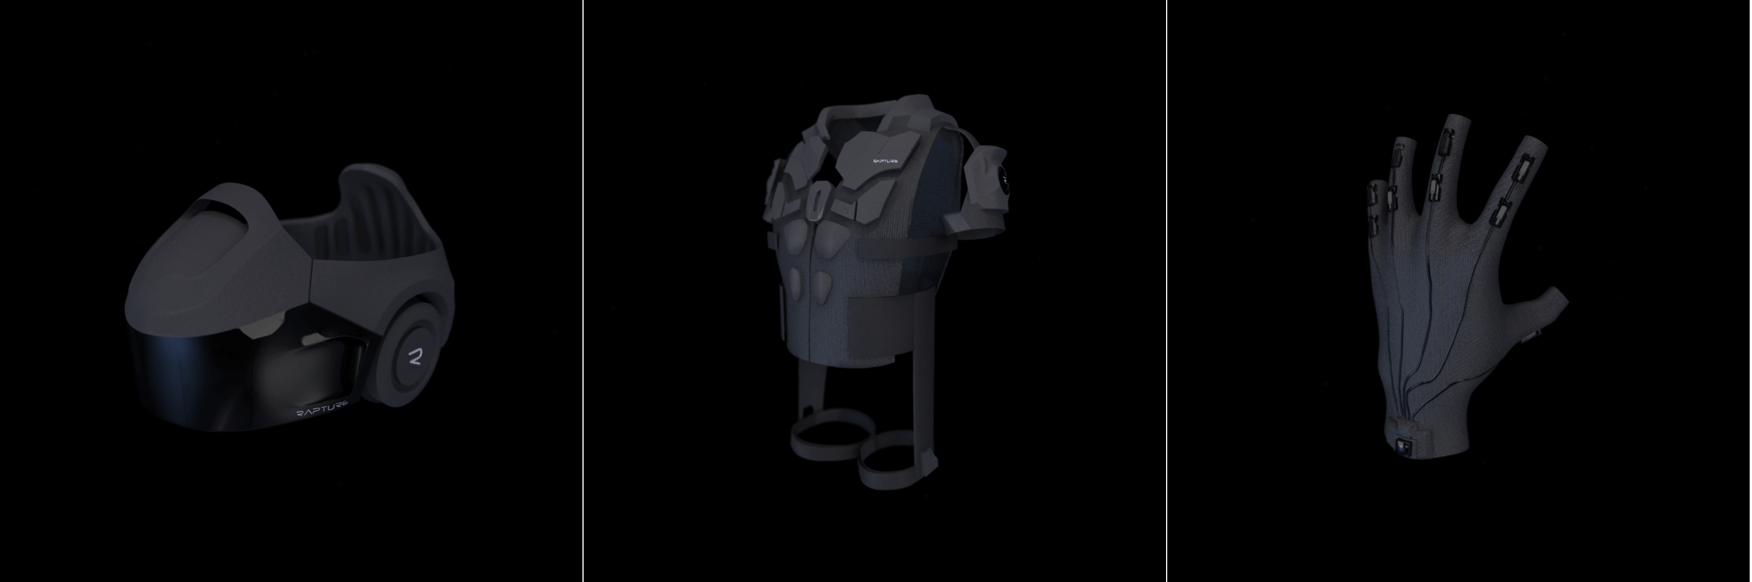
The Void
“Rapture” tech:
Rapture HMD
Dual High-Density Curved OLED Displays
High-Quality THX Headphones
Inline Microphones
Global & Head Tracking Sensors
Rapture Vest
Multiple feedback points
Rapture Gloves
Allows user to interact with Virtual Environment
Notes:
Rapture equipment used in all attractions
rapture gloves similar to the data gloves used with the eyephone

Slide 21
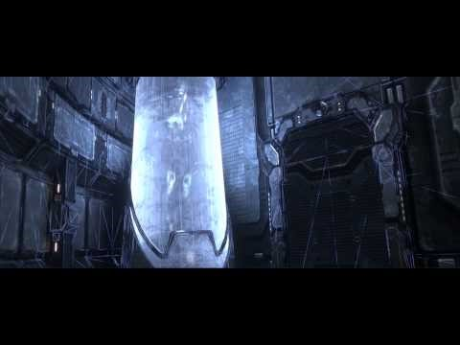
The Void
www.youtube.com/watch?v=rtrg89upnL4&feature=youtu.be
Notes:
the following is the first ad for the theme park

Slide 22
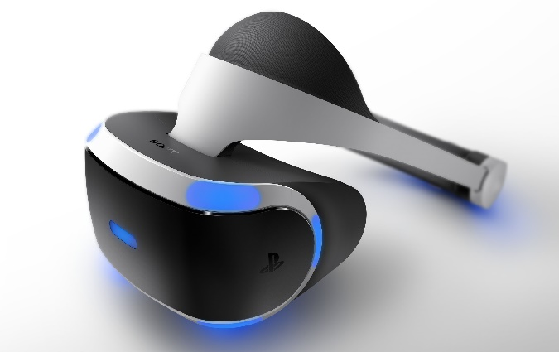
PlayStation VR
Formerly known as “Project Morpheus”
Single OLED display
1920x1080
90-degree field of view
3D stereo audio
Used with:
PlayStation Camera
PlayStation Move controller
PlayStation Dualshock 4 controller
Quarter 1 of 2016 release date
Notes:
Camera:
positional tracking
Move
Already existing

Slide 23
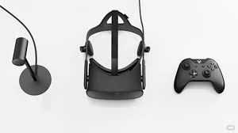
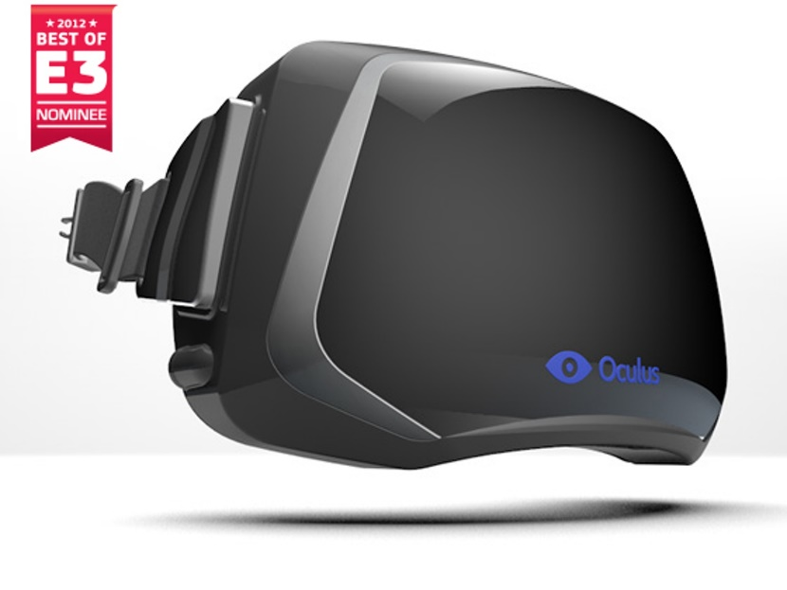
Oculus Rift
Open platform VR headset
Gained interest from
Kickstarter
Works with Windows PC
2 OLED panels
1080x1200
3D audio
100-degree field of view
Used with:
Oculus Constellation
Xbox One controller
Oculus Touch
Quarter 1 of 2016 release date
Notes:
Developed by Oculus VR
American VR tech company
Kickstarter campaign in 2012
Raised $2.4 million along with a lot of interest
Constellation:
positional tracking system
uses infared LEDs
Oculus Touch
Oculus’ own gaming controllers
Comes in a pair
Also offered are dev kits for OSX and Linux

Slide 24
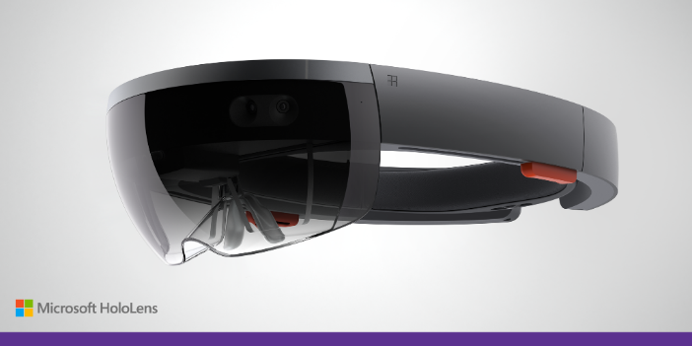
Microsoft’s HoloLens
Codenamed “Project Baraboo”
Used with Windows HoloStudio
3D optical head-mounted display
depth camera
accelerometer
gyroscope
magnetometer
Development Edition currently available
$3,000 per device; limit 2
Application required
[10]
Notes:
Microsoft’s answer to PlayStation's VR and the Oculus Rift
Uses more of a “smart-glass” approach than competitors
less of the user’s field of view is covered
HoloStudio:
3D modeling application

Slide 25
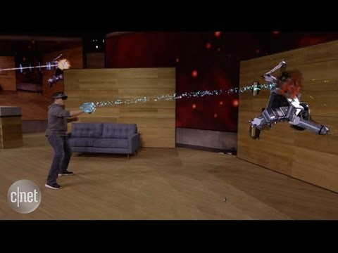
Microsoft’s HoloLens
October 6, 2015: Microsoft’s Project X-Ray debut utilizing the company’s HoloLens
www.youtube.com/watch?v=A_NeDEPKvcA

Slide 26
Additional Information/Open Source Software
Wings3D: 3D modeler
http://www.wings3d.com/
freeWRL: Open Source X3D/VRML viewer
http://freewrl.sourceforge.net/index.html
Cortana3D: 3D viewer with free trial
http://www.cortona3d.com/cortona3d-viewers
VRMLPad: VRML editor
http://www.parallelgraphics.com/products/vrmlpad/
A useful VRML Tutorial:
Lighthouse3D VRML Tutorial
http://www.lighthouse3d.com/vrml/tutorial/

Slide 27
References
[1] Tachi, S. (2013). From 3D to VR and further to telexistence. Artificial Reality and Telexistence (ICAT), 2013. 23rd International Conference, 1-10.
[2] VPL EyePhone Model 1. (2015). VRWiki – a Wiki about VR. Retrieved 12 October 2015 from http://vrwiki.wikispaces.com/VPL+EyePhone.
[3] Fernandes, Antonio Rameriez. (n.d.). VRML Interactive Tutorial. Lighthouse 3D. Retrieved 7 October 2015 from http://www.lighthouse3d.com/vrml/tutorial/.
[4] The Void, LLC. (n.d.). The Void. The Void, LLC. Retrieved 10 October 2015 from https://thevoid.com/.
[5] U.S. Army. (17 February 2011). “Virtual Iraq” Helps Soldiers Overcome PTSD. Fast Company. Retrieved 10 October 2015 from http://www.fastcompany.com/1728656/virtual-iraq-helps-soldiers-overcome-ptsd.
[6] Sambal_Tempe. (6 May 2015). The Void Virtual Reality Theme Park. Youtube. Retrieved 10 October 2015 from https://www.youtube.com/watch?v=rtrg89upnL4&feature=youtu.be.
[7] Project Morpheus (virtual reality). (2015). Wikipedia, The Free Encyclopedia. Retrieved 2 August 2015 from https://en.wikipedia.org/w/index.php?title=Project_Morpheus_(virtual_reality)&oldid=670888538.
[8] Oculus Rift. (2015). Wikipedia, The Free Encyclopedia. Retrieved 2 August 2015 from https://en.wikipedia.org/w/index.php?title=Oculus_Rift&oldid=674035168.
[9] Windows Holographic. (7 October 2015). Wikipedia, The Free Encyclopedia. Retrieved 25 October 2015 from https://en.wikipedia.org/wiki/Windows_Holographic#Microsoft_HoloLens
[10] Davies, Chris. (21 January 2015). This is Microsoft HoloLens. SlashGear. Retrieved 25 October 2015 from http://www.slashgear.com/this-is-microsoft- hololens-21365621/.
[11] CNET News. (6 October 2015). CNET News - Microsoft demos wearable holograms on HoloLens. Youtube. Retrieved 6 October 2015 from https://youtu.be/A_NeDEPKvcA

Slide 28
Questions?

